Slide 1

Making this resource work for you
Prior to teaching this lesson, please refer to the ‘Unit Overview and Planning Document’.
Further guidance on planning Science Mastery lessons can be found in the detailed planning guidance document.
Refer to the ‘notes’ section on each slide for useful information, including suggested expositions, pedagogical content knowledge, suggested questions, answers and more. Consider using presenter mode so you can see this guidance throughout the lesson.
The introduction slides can be adapted to suit your teaching style and the needs of your class.
Before the lesson, adapt the fix-it slide to address any misconceptions identified in the previous lesson’s exit ticket.
Choose from the suggested activities to suit your class. The intention is not that you complete all of these, but that you select those which ones are most appropriate for your students. It may be appropriate to further adapt activities for your students.
These lessons are designed to occupy approximately 1 hour. To adapt for a shorter or longer lesson duration we advise you to adapt the activity section accordingly.
Please consider using the final slide to send feedback about this lesson or examples of PowerPoints that you have adapted to our design team. Your feedback is used to improve Science Mastery for all of our teachers and students. We appreciate all suggestions and comments.
Thank you for reading!
The Science Mastery Team

Slide 2
Linear Graphs
Answer the questions below:
What are the names of the two axes on a graph?
Which is the horizontal axis and which is the vertical axis?
When writing the coordinates of a point, which axis value is given first?
Identify the coordinates of this point.
State the general equation for a straight line.
The $x$ axis and the$y$axis.
The horizontal axis is the $x$ axis and the vertical axis is the $y$axis.
Coordinates are given in the form ($x, y)$
(2,3)
$$y=mx+c$$
x
Notes:
Foundation: Write 10000 in standard form.
Stretch: Write 0.5 kJ in standard form with SI units.
Answers:
Foundation: 1 x10⁴
Stretch: 5 x 10² J

Slide 3
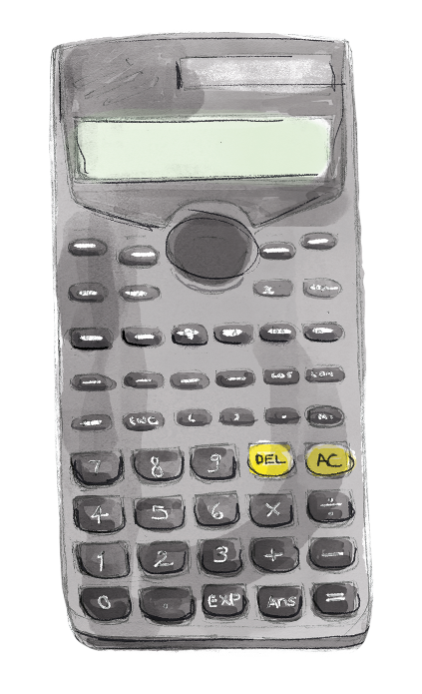
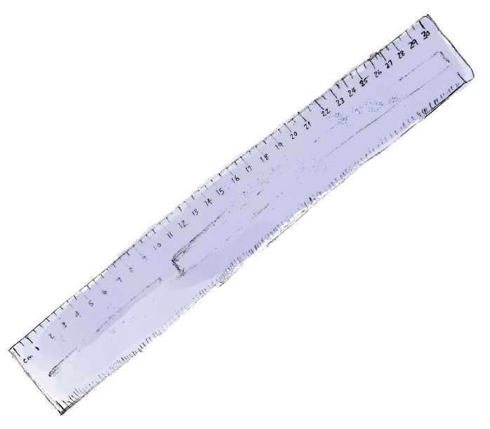
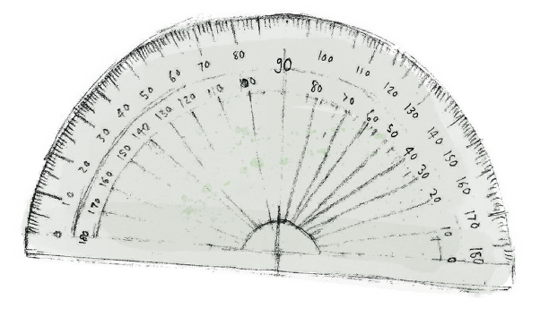

Maths in Science Lesson 17
25/05/2022
Linear Graphs
Lesson 15: Standard Form
Lesson 16: Orders of Magnitude
Lesson 17: Linear Graphs
Lesson 18: Using Equations
Lesson 19: Probability
Lesson 20: Derived Quantities
Notes:
In this lesson pupils will learn to calculate the gradient of a linear graph and understand that a linear graph is represented by the general equation y=mx +c. From P2.1 they have looked at distance-time graphs qualitatively, comparing the speeds of objects by looking at relative steepness. In this lesson they will learn that the gradient can be calculated to give the speed, leading into calculating the acceleration from the gradient of a velocity-time graph in the next lesson.
Introducing this lesson:
What does the word gradient mean?

Slide 4

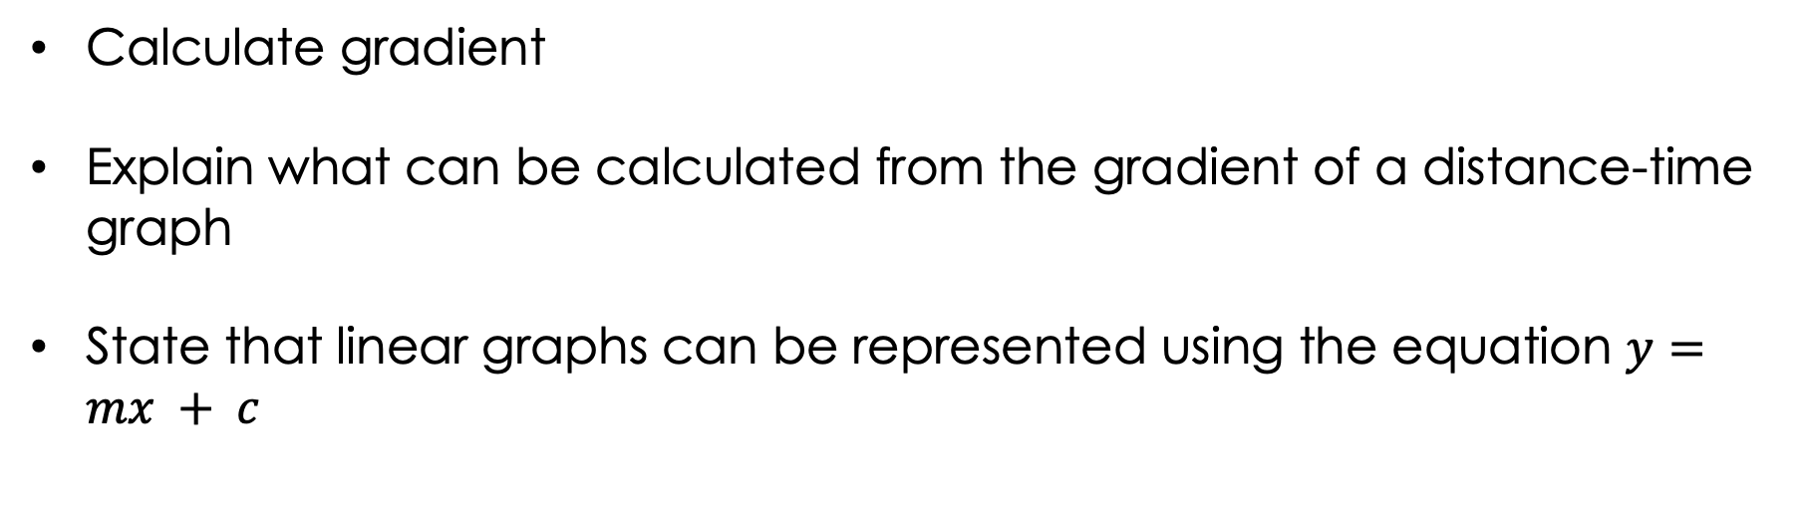
Following this lesson, students will be able to:
Calculate gradient
Explain what can be calculated from the gradient of a distance-time graph
State that linear graphs can be represented using the equation $y=mx + c$
Key Words:
linear
gradient
slope
speed
axis
intercept

Slide 5
This is the fix-it portion of the lesson
The fix-it is an opportunity to respond to gaps in knowledge, especially those identified by the previous lesson’s exit ticket.
The teacher should customise this slide as needed, to facilitate
reteach, explanation, demonstration or modelling of ideas and concepts that students have not yet grasped or have misunderstood.
practise answering specific questions or of key skills.
redrafting or improving previous work.
Notes:
Purpose: to spend time on any gaps identified in previous learning from exit ticket feedback.

Slide 6
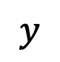
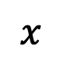
What is gradient?
The gradient is the ‘steepness’ of the slope at any point.
On a straight line, the gradient is constant (the steepness doesn’t change).
On a curved line, the gradient changes at every point.
The gradient can be positive (sloping upwards), negative (sloping downwards), or zero (horizontal).
A
$$y$$
B
C
$$x$$
Which lines (A, B, or C) have a positive gradient?
B and C
Which lines (A, B, or C) have a constant gradient?
A and B
Notes:
Exposition type: explanation
Suggested exposition:
We’ve looked at gradient before when we looked at distance-time graphs and you will have seen the word gradient before in maths, or maybe in some real world scenarios. When we talk about the gradient of a hill or the gradient of a treadmill, what do we mean?
Gradient means the steepness of a slope at any point. The higher the gradient, the more steep the line. On a straight line, the gradient is the same, which we describe as ‘constant’. This means that the steepness of the line is the same throughout. On a curved line, the steepness changes at each point, meaning that the gradient is not constant.
Gradient can be positive, negative or zero. A positive gradient is a line that slopes upwards, a negative gradient is a line that slopes downwards and a gradient of 0 is a horizontal line. This means that there is no steepness at all.
Which lines have a positive gradient?
B and C. They both slope upwards.
Which lines have a constant gradient?
A and B. They are straight lines.

Slide 7
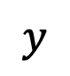
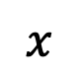
Finding the gradient
To calculate the gradient of a straight line, we need to know the coordinates of the start and the end points of the line.
B
x
$$y$$
What are the coordinates of point A?
x
A
(1,2)
What are the coordinates of point B?
(5,3)
$$x$$
Notes:
Exposition type: explanation
Suggested exposition:
We can calculate a numerical value for the gradient, which makes it easier for us to compare the steepness of different lines. We could do this just by looking at the slopes (like we did with distance-time graphs) but having numbers to compare makes our comparison more scientific.
To calculate the gradient we need to know the coordinates of the start and end points of the line. Remember we write coordinates with the x value first, followed by the y value. The start point is the one that comes first on the x axis. It is also usually closer to the origin.
What are the coordinates of point A?
(1,2)
What are the coordinates of point A?
(5,3)

Slide 8
Choose the correct answer for each question:
A. Gradients can be…
Positive
Negative
Zero
All of the above
B. To find the gradient of a straight line you need…
The labels of each axis
The coordinates of the start and end points
The coordinates of the origin
The equation for a straight line
C. The gradient is…
The shape of a line
The thickness of a line
The length of a line
The steepness of a line

Slide 9
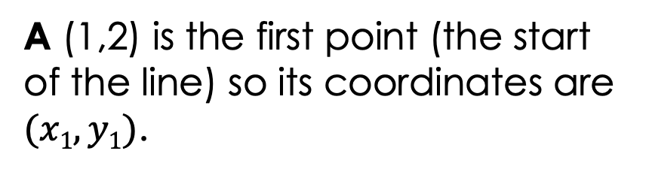
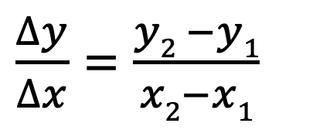
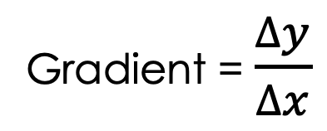
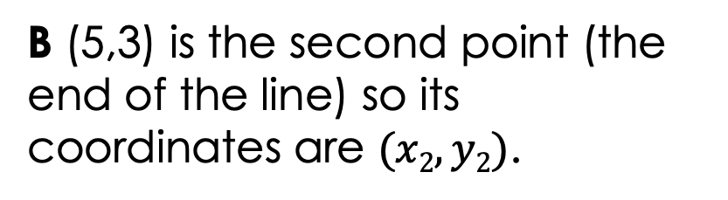
Finding the gradient
To calculate the gradient we use the equation:
Gradient = $\frac{∆y}{∆x}$
$\frac{∆y}{∆x}$ = $\frac{y2 −y1}{x2−x1}$
B
x
$$y$$
x
A
A (1,2) is the first point (the start of the line) so its coordinates are $(x1, y1)$.
B (5,3) is the second point (the end of the line) so its coordinates are $(x2, y2)$.
$$x$$
Notes:
Exposition type: explanation
Suggested exposition:
To calculate the gradient we use our coordinates and put them into an equation.
The gradient is calculated using the equation: gradient = (change in y)/change in x.
You will see this triangle symbol often in physics - it is the Greek letter delta and means ‘change in’.
Just like how we calculate change in velocity when calculating acceleration, we use the same method here: final value - initial value.
Change in y = y2 - y1
Change in x = x2 - x1
Our point A is the first point (initial point/initial value) as it was first on the x axis, so we use point A as (x1, y1) and point B as (x2, y2).

Slide 10


Finding the gradient
To calculate the gradient we use the equation:
Gradient = $\frac{∆y}{∆x}$
$\frac{∆y}{∆x}$ = $\frac{y2 −y1}{x2−x1}$
B
x
$$y$$
(5,3)
Gradient = $\frac{3 − 2}{5 − 1}$
x
A
(1,2)
Gradient = $\frac{1}{4}$
Gradient = 0.25
$$x$$
Notes:
Exposition type: explanation
Work through the example showing pupils where each number fits in - this is the ‘I’ part of the cycle.
Suggested exposition:
Once we have substituted in the coordinates in the right order, we simply have to solve the equation.
In this situation our calculated gradient = 0.25. Gradient itself does not have a unit as it is a measure of the steepness of the line. 0.25 is a relatively small gradient, which makes sense because this line is not particularly steep. A gradient value of 0 would be a horizontal line, so this is steeper than that.

Slide 11


Finding the gradient
To calculate the gradient we use the equation:
B
(2,5)
x
Gradient = $\frac{∆y}{∆x}$
$\frac{∆y}{∆x}$ = $\frac{y2 −y1}{x2−x1}$
$$y$$
Gradient = $\frac{5 −1}{2 − 1}$
A
x
Gradient = $\frac{4}{1}$
(1,1)
Gradient = 4
$$x$$
Notes:
Guidance:
Work through the example with pupils - this is the ‘we’ part of the cycle.

Slide 12

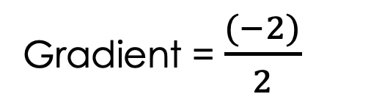
Finding the gradient
To calculate the gradient we use the equation:
Gradient = $\frac{∆y}{∆x}$
$\frac{∆y}{∆x}$ = $\frac{y2 −y1}{x2−x1}$
A
x
$$y$$
(1,3)
Gradient = $\frac{1 − 3}{3 −1}$
x
B
Gradient = $\frac{(−2)}{2}$
(3,1)
Gradient = -1
$$x$$
Notes:
Guidance:
Get pupils to describe the process to you - this is the ‘you’ part of the cycle.
We still use point A as the start point of the line, because it comes first on the x axis. This time however, we calculate our gradient as a negative number. This is because we have a negative gradient as it is sloping downwards. When writing a negative gradient we include the negative sign, but we do not include the positive sign for a positive gradient as this is assumed.

Slide 13
Finding the gradient
What is the gradient of this line?
✓
A. 0.33
B. 3
C. 0.66
D. 2
$$y$$
B
x
(4,2)
(1,1)
A
x
$$x$$
Notes:
Gradient = change in y/change in x
Gradient = (2 - 1)/(4 - 1)
Gradient = 0.33
If students answer B they have used change in x/change in y

Slide 14

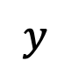
What does the gradient show?
What quantities go on each axis of a distance-time graph?
Time is on the $x$ axis and distance is on the $y$ axis.
$$y$$
Describe the motion of this object from the distance-time graph.
The object travels 3 metres in 2 seconds and is then stationary for 3 seconds.
$$x$$
Notes:
Guidance:
This is an opportunity to get students to think about where they have seen gradient in science before and recap the key points of a distance-time graph.
Suggested guidance:
Talk tasks can be used in a variety of ways to suit the particular needs of the students you are teaching. Through exchanging views with others, students develop their understanding of the science beyond what could be achieved individually.
Science classrooms that successfully integrate talk have the following features:
Science talk is a regular feature of lessons and is woven into classroom activities.
Students are paired or grouped strategically by the teacher to ensure productive interaction. This might take into consideration the students’ proficiency of the English language, how encouraging they might be to peers and their attainment in the topic. It’s a good idea to consider these pairings in the class seating plan.
Students are encouraged and supported to talk, but are not forced to talk.
The teacher should take on the role of a facilitator, engaging with conversations where necessary and encouraging or steering the conversation where needed.
Students are encouraged to use the language they have to express their ideas (e.g., everyday language, imperfect English, native language), but also to incorporate science specific terminology where this is more accurate or has been taught.
6. Scientifically inaccurate ideas are not dismissed by the partner or teacher; open discussion and further investigation are relied on to help students construct ideas that support them to progress in their scientific understanding.
7. Guidelines for behaviour during talk tasks are explicit and frequently reviewed. Rules for students might be:
Listen carefully to your partner
Take turns talking.
Speak one at a time, without interrupting.
Politely agree or disagree and explain why.
Politely point out if your partner has used a scientific word incorrectly, if they have explained the science incorrectly, or if there is a more accurate way to describe something.
If confused, ask questions.
Stay focused on the discussion topic.
Respond to one another.

Slide 15
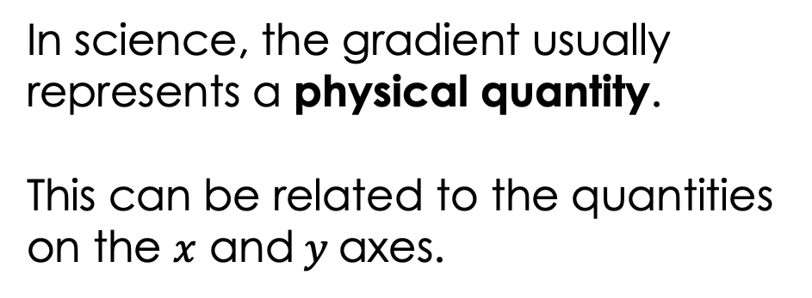
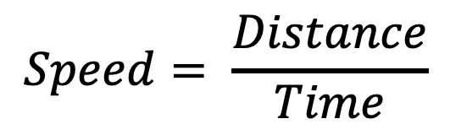
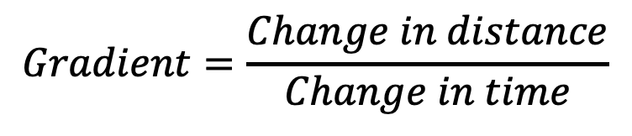
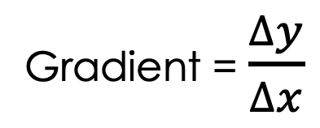
What does the gradient show?
In science, the gradient usually represents a physical quantity.
This can be related to the quantities on the $x$ and$y$axes.
Gradient = $\frac{∆y}{∆x}$
Distance (m)
$$Gradient=\frac{Change in distance}{Change in time}$$
$$Speed= \frac{Distance}{Time}$$
Time (s)
Therefore the gradient is equal to the speed.
Notes:
Exposition type: explanation
Suggested exposition:
In maths, the gradient is usually just a pure numerical value but in science it often represents a physical quantity. This quantity is related to the other quantities that have been plotted on the x and y axes. Remember that gradient is the change in y divided by the change in x.
If we look at the gradient of a distance-time graph, we would use change in distance as change in y (because distance is on the y axis) and change in time as change in x (because time is on the x axis).
What would we get if we used the change in distance divided by the change in time?
Speed!
This means that by calculating the gradient of a distance-time graph, we can actually calculate the speed for that part of the graph. Distance-time graphs often have different parts or sections to them, so we consider each section as a separate line and calculate the gradient for each separately.

Slide 16

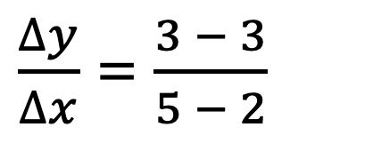

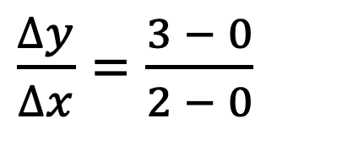
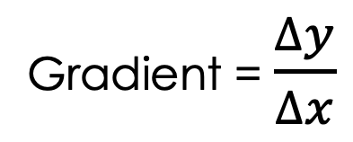
What does the gradient show?
Gradient = $\frac{∆y}{∆x}$
From A to B:
$\frac{∆y}{∆x}$ = $\frac{3 − 0}{2 − 0}$
Gradient = $\frac{3}{2}$
B
C
Gradient = 1.5
Distance (m)
Therefore speed = 1.5 m/s
From B to C:
$\frac{∆y}{∆x}$ = $\frac{3 − 3}{5 − 2}$
A
Gradient = $\frac{0}{3}$
Time (s)
Gradient = 0
Therefore speed = 0 m/s
Notes:
Exposition type: explanation
Suggested exposition:
Let’s split our distance-time graph into the different sections: A-B and B-C.
Let’s first calculate the gradient between A and B.
We follow the same method, identifying our start and end points of the line (A is the start point and B is the end point).
Then we substitute the values from our points into our equation (y2-y1)/(x2-x1)
This gives us a value for the gradient of 1.5. We know that the gradient of a distance-time graph is the speed so the speed of the object between A and B is 1.5 m/s.
Now let’s calculate the gradient between C and C.
We follow the same method, identifying our start and end points of the line (B is the start point and C is the end point).
Then we substitute the values from our points into our equation (y2-y1)/(x2-x1)
This gives us a value for the gradient of 0, because 0 divided by anything is 0. When we have a horizontal line on a distance-time graph, no distance is being covered per unit time because the y value is not increasing. No distance being covered per unit time means a speed of 0 m/s so a horizontal line on a distance-time graph shows a stationary object.

Slide 17
Determine if each statement is true or false:
The gradient is steepest between 3 and 5 seconds.
Between 1 and 3 seconds the object is stationary.
The gradient on a distance-time graph is similar to the speed.
The speed during the first second is 3 m/s.
False
Distance (m)
True
False
True
Time (s)
Notes:
False - it is steepest between 0 and 1 second. You may wish to verify this with pupils by calculation.
True
False - it is not similar, it is the speed. Change in distance (y) divided by change in time (x) gives speed.
True

Slide 18
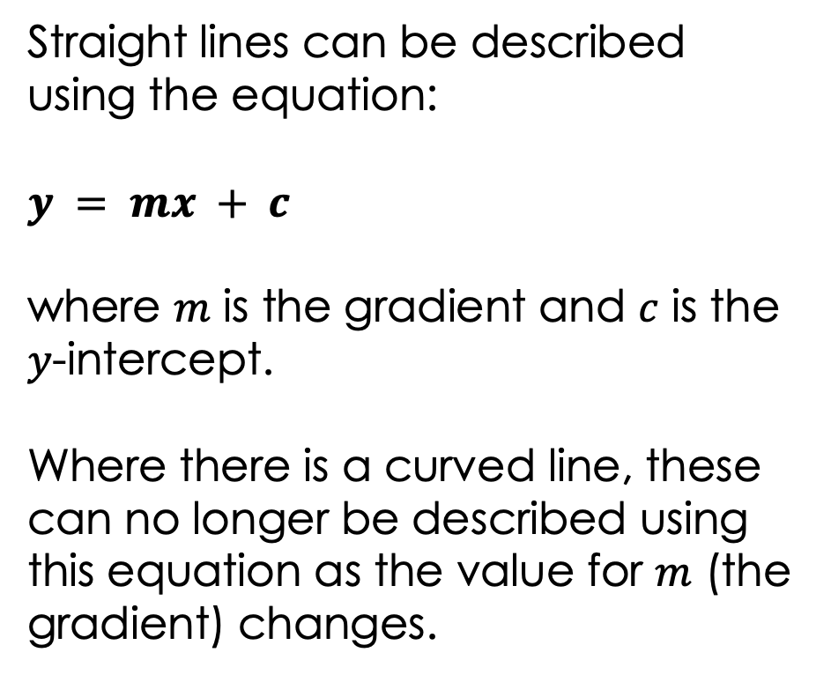
Describing linear graphs
Straight lines can be described using the equation:
$$y = mx + c$$
where $m$ is the gradient and $c$ is the $y$-intercept.
Where there is a curved line, these can no longer be described using this equation as the value for $m$ (the gradient) changes.
Notes:
Exposition type: explanation
Suggested exposition:
We know from maths that a straight line can be described using the equation y=mx+c and that we can use this equation to predict where points will fall, allowing us to extrapolate or extend the graph.
m is the gradient and c is the y intercept
Where we have a curved line, the gradient is changing and therefore the value of m is changing. This means that a curved line cannot be described using this equation.
Note: the skill being shown here is simply for pupils to recognise that a straight line can be described with the y=mx+c equation. Pupils are not required to use it for calculations or substitutions.

Slide 19
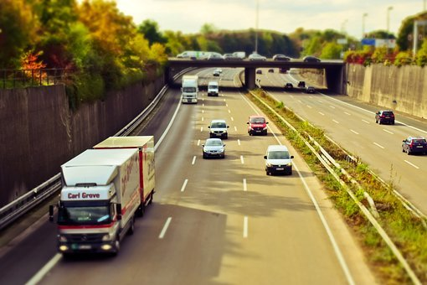
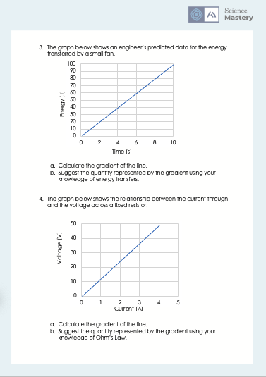
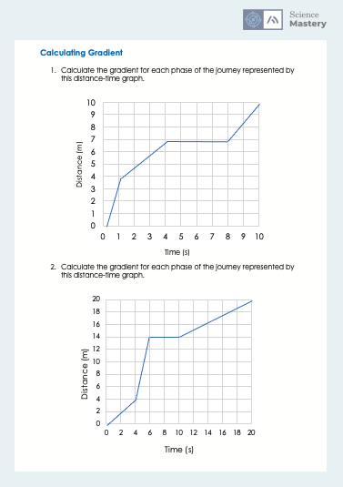
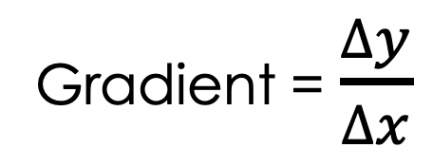
Calculating Gradient
For each graph, calculate the gradient.
Calculate any quantities you can from the gradient.
Show all working.
Gradient = $\frac{∆y}{∆x}$

Slide 20
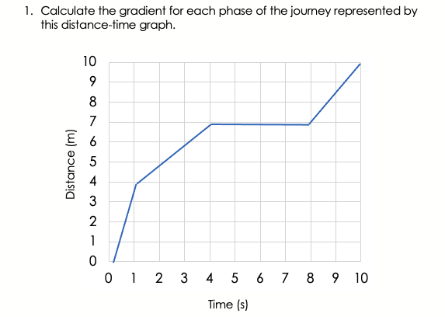
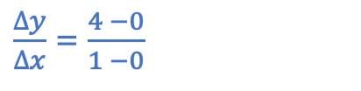
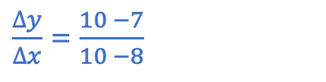
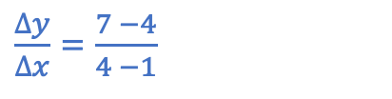
$\frac{∆y}{∆x}$ = $\frac{10 −7}{10 −8}$
Gradient = 0
Gradient = 1.5
$\frac{∆y}{∆x}$ = $\frac{7 −4}{4 −1}$
Gradient = 1
$\frac{∆y}{∆x}$ = $\frac{4 −0}{1 −0}$
Gradient = 4

Slide 21
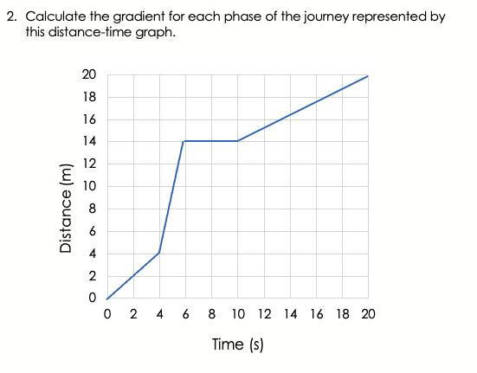
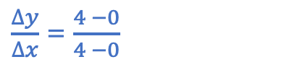
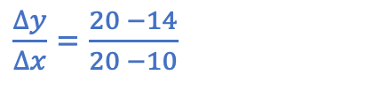
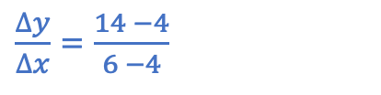
$\frac{∆y}{∆x}$ = $\frac{20 −14}{20 −10}$
Gradient = 0
Gradient = 0.6
$\frac{∆y}{∆x}$ = $\frac{14 −4}{6 −4}$
Gradient = 5
$\frac{∆y}{∆x}$ = $\frac{4 −0}{4 −0}$
Gradient = 1

Slide 22
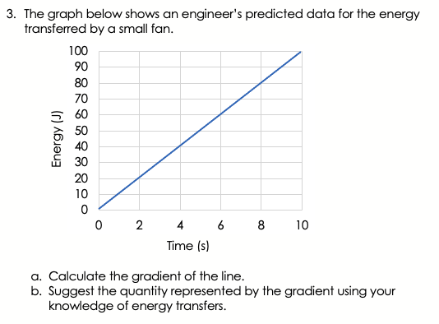
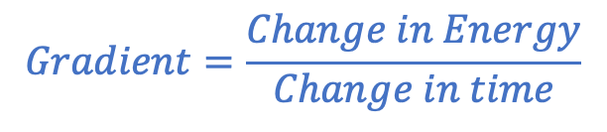
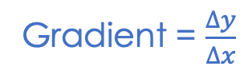
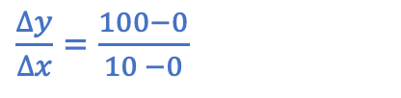
$\frac{∆y}{∆x}$ = $\frac{100−0}{10 −0}$
Gradient = 10
Gradient = $\frac{∆y}{∆x}$
$$Gradient=\frac{Change in Energy}{Change in time}$$
Gradient = Power
Notes:
Pupils can choose to work out the gradient using any two points. You may want to show them how this will result in the same value for gradient because it is a straight line.
Change in energy over time = power
You may want to show pupils this using the symbols E and t so they can put it into the equation they know.

Slide 23
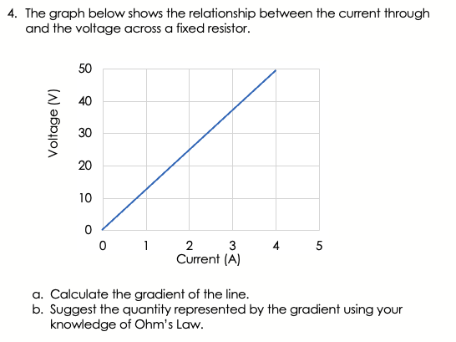

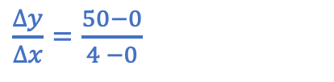
$\frac{∆y}{∆x}$ = $\frac{50−0}{4 −0}$
Gradient = 12.5
Gradient = $\frac{∆y}{∆x}$
$$Gradient=\frac{Voltage}{Current}$$
Gradient = Resistance
Notes:
Pupils can choose to work out the gradient using any two points. You may want to show them how this will result in the same value for gradient because it is a straight line.
Voltage/current = resistance

Slide 24
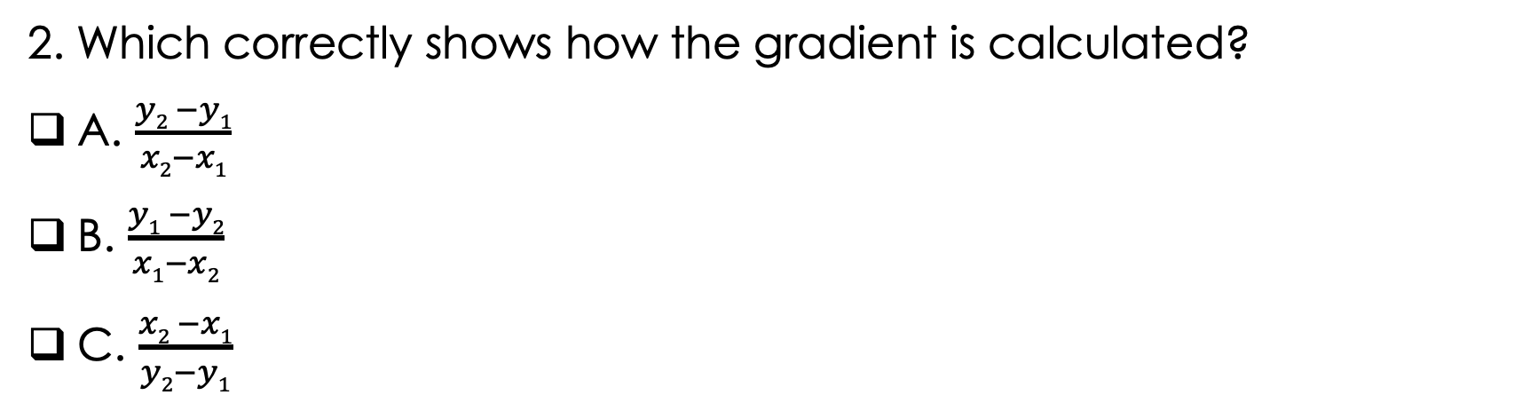
Answer the questions below.
Which is the best description of the gradient of a graph?
A. How much it slopes upwards
B. Its steepness
C. How fast an object is going
✓
2. Which correctly shows how the gradient is calculated?
A. $\frac{y2 −y1}{x2−x1}$
B. $\frac{y1 −y2}{x1−x2}$
C. $\frac{x2 −x1}{y2−y1}$
✓
3. What does the gradient of a distance-time graph represent?
A. The speed of an object
B. An object that is stationary
C. How far an object has travelled
✓
Notes:
Answer: B
If students answer A, they have assumed that a gradient is always positive. If students answer C, they have confused the general idea of gradients with the gradient of a distance-time graph (speed). To fix-it, you may want to get pupils to practice calculating the gradient (both positive and negative) and give them examples that are not based on distance-time graphs, such as rate of reaction graphs.
2. Answer: A
If students answer B, they have correctly chosen y/x but got the values the wrong way around. If students answer C, they have not understood that gradient is change in y divided by change in x. To fix-it, give pupils a further example where they first identify the coordinates of a point and then colour code these within the gradient calculation.
3. Answer: A
If students answer A, they have confused the idea of a zero gradient with all gradients. If students answer C, they may confused the definitions of speed and distance. To fix-it, get pupils to practice describing the motion of an object on a distance-time graph and calculate speed at all points.

Slide 25
Maths in Science Lesson 17
What was good about this lesson? | What can we do to improve this lesson?
Send us your feedback by clicking this link. Thank you!

